Slide 1


The frontline training platform built by operators, for operators
© 2024 PINEAPPLE ACADEMY

Slide 2

Frustrated by constant operational challenges?
Poor operational output and lack of consistency amongst team members?
Employees falling short of standards set by leadership?
Gaps in current process and procedures?
Inability to create SOP’s to assist and develop deskless workforce?
Spending too much time and money on lengthy and ineffective onboarding?
© 2024 PINEAPPLE ACADEMY

Slide 3


Our solution.
Pineapple Academy provides an online knowledge management system built by operators, for operators.
Our proprietary training platform provides a simple, quick, and effective solution to driving operational consistencies and efficiencies.
We help you meet employees where they are, using engaging, 5-minute or less skills videos and courses for optimum retention.
© 2024 PINEAPPLE ACADEMY

Slide 4
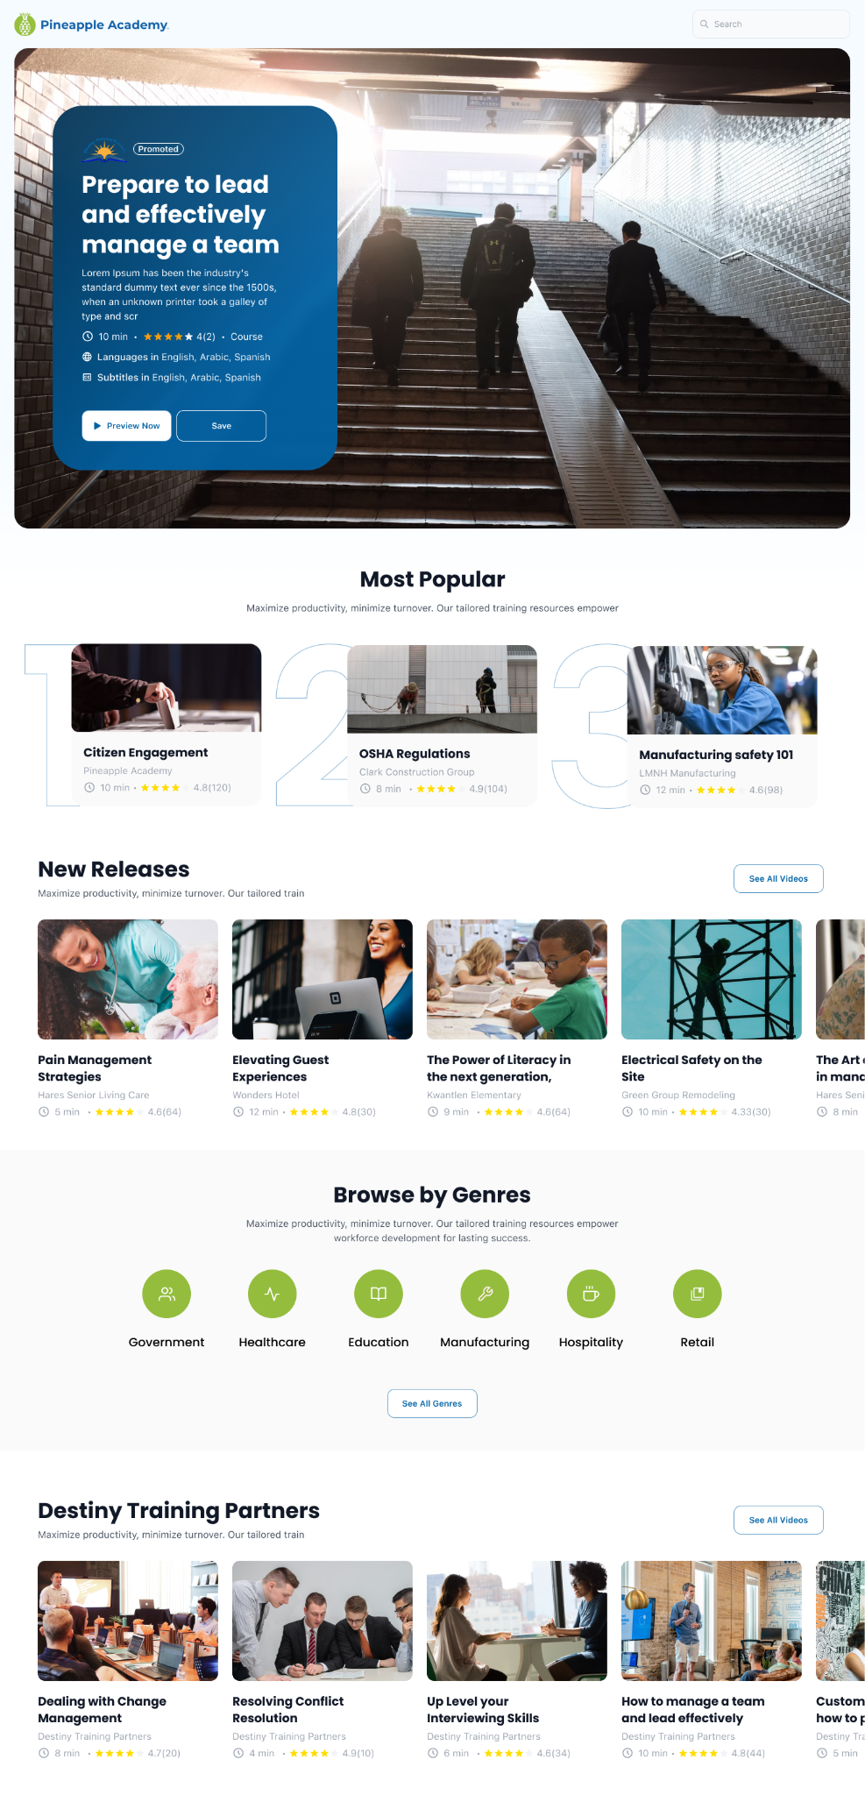
How we do it.
Choose from 1000+ ready-to-use videos or courses from our microlearning marketplace, or create your own training assets with our easy-to-use authoring tool and editing services.
Share and stream training through any platform, company software, SCORM files, or through trackable QR codes or links accessible in an employee’s existing workflow.
Track and analyze results to make more informed decisions and increase employee training adoption and utilization.
© 2024 PINEAPPLE ACADEMY

Slide 5
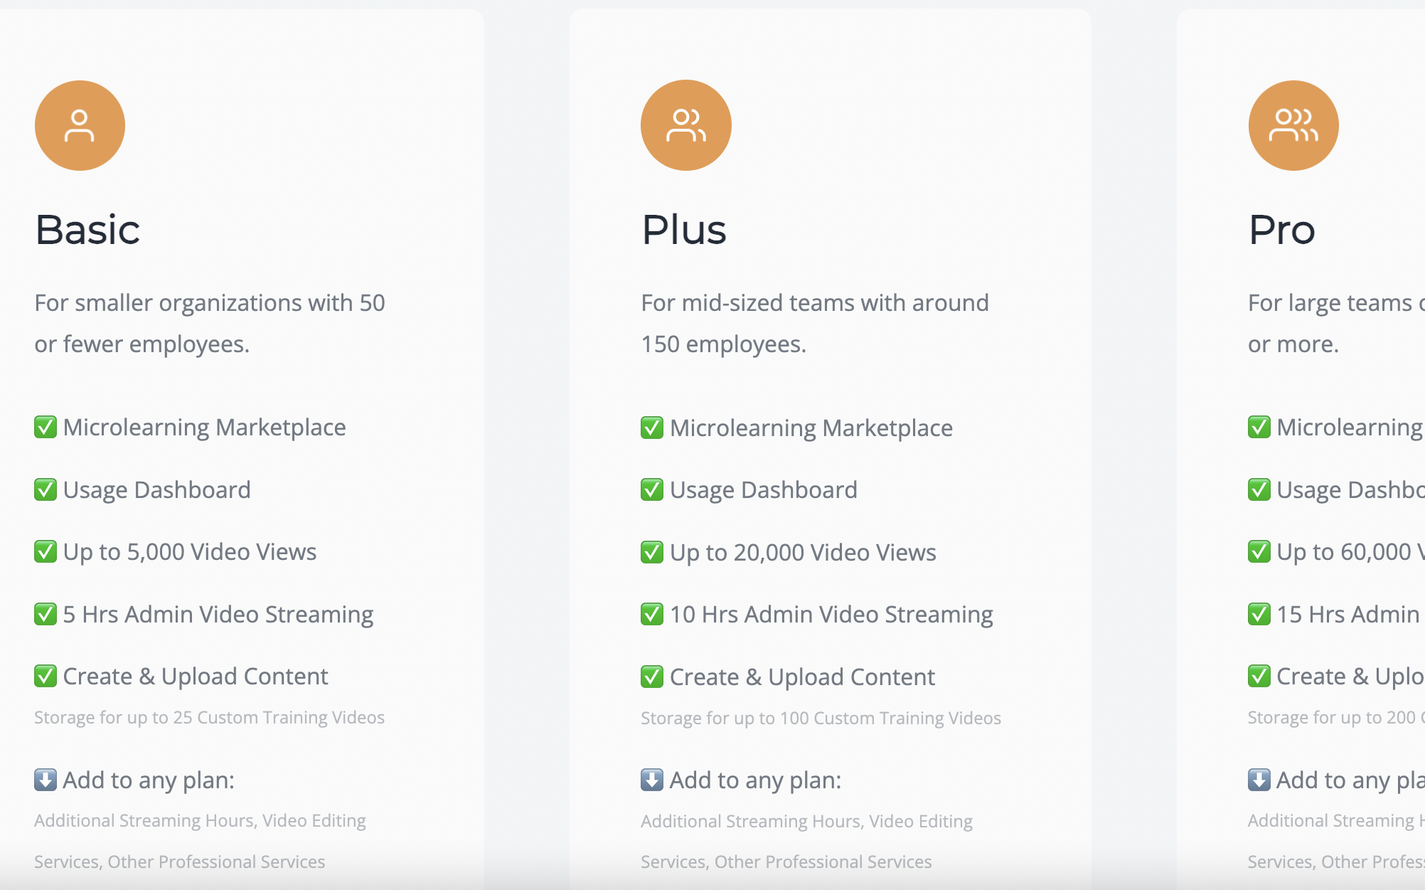
Simple pricing.
We offer a subscription unlike any other on the market. Your success is tied directly to our success.
With simple pricing and flexible hourly subscriptions, pay only for what you need.
100% yield is always the goal.
Add video editing services, additional hours, or other professional services to any size plan.
© 2024 PINEAPPLE ACADEMY

Slide 6
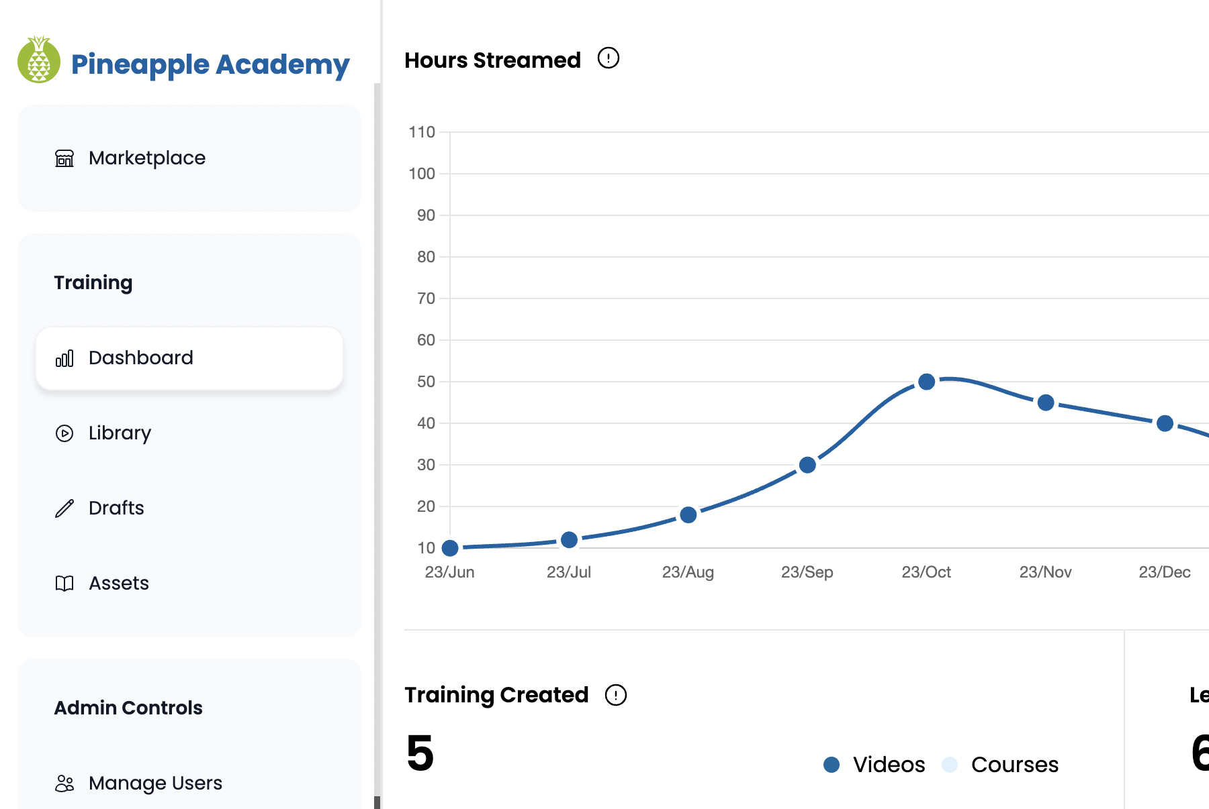
FAQ’s
What industries does Pineapple Academy serve?
Any and all!
Can I stream training through any software?
Yes, we’re compatible with nearly any platform – you name it, we can make it happen.
How does billing work?
Pay by month, quarter, or annually.
Can I upload my own training videos through Piña 3.0?
Absolutely.
Can I create my own courses and quiz questions?
If you can dream it, you can create it.
© 2024 PINEAPPLE ACADEMY

Slide 7

What’s next?
#gopineapple
pineappleacademy.com
sales@pineappleacademy.com
© 2024 PINEAPPLE ACADEMY

